Slide 1


AMC ENGINEERING COLLEGE Department of Information Science and Engineering
AI TRADING BOT

Slide 2
AMC ENGINEERING COLLEGE Department of Information Science and Engineering
GROUP 14
18SCP77 – PROJECT WORK PHASE - II
GUIDE | Prof. NAGASHREE K T
USN | NAME
1AM20IS110 | VISHARAD VIDYASAGAR (LEADER)
1AM20IS086 | SHAIK ARSHIYA
1AM20IS095 | SNEHA NAGARAJ SHET
1AM20IS109 | VINUTA S SINNUR

Slide 3
AMC ENGINEERING COLLEGE Department of Information Science and Engineering
INTRODUCTION
AI trading bot is a computer program designed to execute buy or sell orders on financial instruments, such as stocks or cryptocurrencies, without direct human intervention. Unlike traditional trading methods, AI trading bots operate tirelessly, 24/7, analyzing market data, identifying patterns, and making split-second decisions based on predefined rules or learned behaviors.
The significance of AI in trading lies in its ability to process vast amounts of historical and real-time data at speeds beyond human capacity. Machine learning algorithms within these bots can discern intricate patterns and trends, adapting strategies to changing market conditions. By harnessing computational power, AI trading bots aim to optimize trading outcomes, enhance portfolio management, and minimize emotional biases inherent in human decision-making

Slide 4
AMC ENGINEERING COLLEGE Department of Information Science and Engineering
PROBLEM STATEMENT
Investing in stock market is not an easy task, as it needs learning and practice for years. Even after this, people end up getting losses and lose their money. Seeing the stock market pattern daily and analyzing is also a very big task.
AI trading bots employ sophisticated algorithms and machine learning techniques to analyze the collected data. They identify patterns, trends, correlations and other indicators that may suggest potential trading opportunities beyond regular financial analysis. Based on the analysis of the data, the AI trading bot develops trading strategies or uses predefined strategies programmed into its system. The bot then executes trades on behalf of the user, sending orders to the exchange or trading platform. AI trading bots incorporate risk management techniques to control and minimize potential losses. These techniques may include setting stop-loss orders, position-sizing algorithms or implementing trailing stops to protect profits.

Slide 5
AMC ENGINEERING COLLEGE Department of Information Science and Engineering
ABSTRACT
The primary objective is to achieve maximum profits with minimal risk, surpassing the results of conventional human trading strategies. To accomplish this, the project will delve into a range of advanced AI techniques and strategies such as Golden Cross and Death Cross, assessing their performance across varying market conditions. The AI Trading Bot holds the promise of reshaping the finance industry, making trading more efficient and accessible for everyone.
The Project utilizes Meta Trader5 and Pine Connector tools for Comprehensive price analysis, access real -time market data, managing trading accounts and making the trading process seamless and efficient. Beyond its technical goals, the project is committed to adhering to all ethical standards and financial trading regulations

Slide 6
AMC ENGINEERING COLLEGE Department of Information Science and Engineering
LITERATURE SURVEY
Zhang et. al., [1] "A Deep Reinforcement Learning Approach for Stock Trading (2018)”. This paper explores the application of Deep Reinforcement Learning (DRL) for stock trading, specifically focusing on policy gradient methods. The authors propose a DRL agent that interacts with a simulated stock market environment to learn optimal trading strategies.
Jiang et. al., [2] "An Ensemble Learning Framework for Algorithmic Trading" (2019, IEEE Transactions on Computational Intelligence and Financial Economics). This paper proposes an ensemble learning framework for algorithmic trading, combining multiple machine learning models to improve prediction accuracy and generate profitable trading signals.
Salah Bouktif et. al., [3] "Augmented Textual Features-Based Stock Market Prediction". This paper explores the use of textual features alongside traditional historical data to improve stock market prediction accuracy. The paper proposes a novel approach that utilizes sentiment analysis, n-grams, and customized textual features extracted from news articles and financial reports, in addition to historical stock prices and technical indicators.

Slide 7
AMC ENGINEERING COLLEGE Department of Information Science and Engineering
LITERATURE SURVEY
4. Arya Yudhi Wijaya et. al., [4] “Stock Price Prediction with Golden Cross and Death Cross on Technical Analysis Indicators Using Long Short-Term Memory (2022)”. This paper explores the use of Long Short-Term Memory (LSTM) networks for stock price prediction, incorporating Golden Cross and Death Cross signals as additional technical indicators. The paper investigates the effectiveness of combining LSTM models with Golden Cross and Death Cross, two popular technical analysis indicators that signal potential trend changes from bearish to bullish (Golden Cross) or vice versa (Death Cross).
5. Gourav Bathla et. al., [5] "Stock Price prediction using LSTM and SVR (2020)". The paper highlights that stock price movement is non-linear and complex, and traditional approaches such as Linear Regression and Support Vector Regression were used but the accuracy was not adequate. The paper introduces a method where LSTM is compared with SVR using various stock index data such as S&P 500, NYSE, NSE, BSE, NASDAQ, and Dow Jones Industrial Average for experiment analysis.

Slide 8
AMC ENGINEERING COLLEGE Department of Information Science and Engineering
LITERATURE SURVEY
Xiaojian Weng et. al.,[6] "Stock Price Prediction Based on LSTM and Bert (2022)". This model addresses the limitations of traditional stock forecasting models, which are based on statistical regression models and often struggle to characterize the influential relationships between multiple variables, leading to large prediction errors. The proposed model first calculates the investor sentiment before the stock opening by fine-tuning the BERT model.
7. Sparsh Vohara et. al., [7] "Stock Price Trend Analysis and Prediction of Closing Price Using LSTM (2023)". Accurate prediction of stock market returns is a challenging task due to the volatile and nonlinear nature of those returns. Investment returns depend on many factors including political conditions, local and global economic conditions, company-specific performance, and many others. Recently, the interest in applying Artificial Intelligence in making trading decisions has been growing rapidly with numerous research papers published each year addressing this topic.

Slide 9
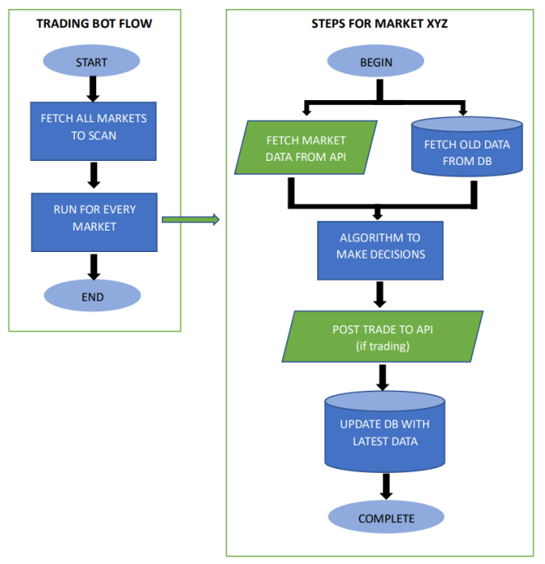
AMC ENGINEERING COLLEGE Department of Information Science and Engineering
ARCHITECTURE DIAGRAM

Slide 10
AMC ENGINEERING COLLEGE Department of Information Science and Engineering
DATA REQUIREMENTS
To build an AI trading bot project using Python, we would typically need the following data and resources:
Trading Platform API: You need access to a trading platform that provides APIs for placing orders. Examples include Alpaca3 and Zerodha4. We are using MetaTrader5 MT5 API and Pine Connector.
MetaTrader 5 (MT5) is a trading platform that allows users to trade stocks, CFDs, forex, and futures. It's available on desktop, mobile, and web, and is designed for non-forex and U.S. markets.
API Credentials: You need to create an API key and secret to access your trading account.
Trading Account: You need a trading account with sufficient funds to execute the orders.

Slide 11
AMC ENGINEERING COLLEGE Department of Information Science and Engineering
DATA REQUIREMENTS
Market Data: You need access to real-time or historical market data for analysis and decision making.
Python Libraries: You would need various Python libraries such as pandas, NumPy, matplotlib for data manipulation and analysis. For interacting with the trading platform, you need specific libraries.
Back testing Framework: To validate your trading strategy, you need a back testing framework that can simulate trading strategies against historical data.

Slide 12
AMC ENGINEERING COLLEGE Department of Information Science and Engineering
MODULES
MODULE I – Fetching Data
MODULE II – Connecting with MT5
MODULE III – Strategy
MODULE IV – Automation

Slide 13
AMC ENGINEERING COLLEGE Department of Information Science and Engineering
MODULE I : Fetching Data & MODULE II : Connection
The Real time data for a specific Ticker or Symbol (Stock Name), for a period of time is taken. The data is fetched using the MT5 of the IC Market broker.
Pine connector is used to connect our code with the IC Market MT5, so that we can initialize the Market Trader automatically instead of opening it manually.
The data retrieved can be of specific intervals, depending on the user’s need. It can be for 1 hour (H1), 2 hours (H2), 1 day (D1) to months (M1, M2, ..).
The data is then loaded as per the need with all basic data like, time, open, close, high, low prices of the stocks.

Slide 14
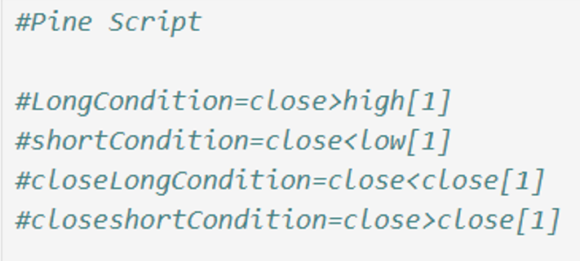
AMC ENGINEERING COLLEGE Department of Information Science and Engineering
MODULE III : Strategy
The working strategy for the bot is pretty easy and simple.
The bot BUYS a stock, and then analyzes the data continuously, when the STOP LOSS or TAKE PROFIT is met, the bot SELLS the stock and completes a Trade.
The same continues if the bot has already executed a BUY Trade, so it works on the LSTM conditions, to perform the next Trades.

Slide 15
AMC ENGINEERING COLLEGE Department of Information Science and Engineering
MODULE IV : Automation
The bot starts to work automatically instead of doing everything manually.
The bot will fetch data, buy, sell stocks on it’s own until the conditions are matched to do so.
The conditions for the TAKE PROFIT or STOP LOSS is done by using a user defined function, which checks for specific conditions to execute a Trade.
The bot can work for n number of times, and on a user’s specific needs.
Which allows the user to follow up their other works, rather than continuously checking the data every time manually
The bot can be put to sleep as per the user’s need as well.

Slide 16
AMC ENGINEERING COLLEGE Department of Information Science and Engineering
METHODOLOGY
LSTM (LONG SHORT-TERM MEMORY)
LSTM is a powerful tool which helps to improve the accuracy of the trading bot. It helps in handling data in a sequential order, it incorporates a memory into a model structure which helps to compute multiple functions at every stage.it detects the trading signals, it prepares the data and utilizes the indicators for daily analysis. Overall, its helps in the predictions .and maintains the bot accuracy and efficiency with better performance.
The integration of LSTM aims to improve the ability to predict trading signals accurately. In basic trading strategies, instead of using the current day's closing price to generate technical indicators and make trading decisions, an LSTM model is applied to predict the future closing price.

Slide 17
AMC ENGINEERING COLLEGE Department of Information Science and Engineering
GOLDEN CROSSOVER
The Golden Cross is a bullish phenomenon when the 50-day moving average crosses above the 200-day moving average. When the market is in a long-term downtrend, the 50-day moving average is below the 200-day moving average. However, no downtrend lasts forever. So, when a new uptrend begins, the 50-day moving average must cross above the 200- day moving average and that’s known as the Golden Cross.
Indicators
• 50-Day SMA (Simple Moving Average), represents the short-term trend.
• 200-Day SMA (Simple Moving Average), represents the long-term trend.
Buy Signal & Sell Signal
• Buy Signal, the 50-Day Average Crosses **ABOVE** the 200-Day Moving average, indicating that there may be a bull-market on the horizon.
• Sell Signal, the 50-Day Average Crosses **BELOW** the 200-Day Moving average, indicating that there may be a bear-market on the horizon

Slide 18
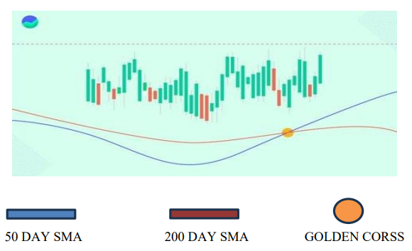
AMC ENGINEERING COLLEGE Department of Information Science and Engineering
GOLDEN CROSSOVER
Buy Signal & Sell Signal
• Buy Signal, the 50-Day Average Crosses **ABOVE** the 200-Day Moving average, indicating that there may be a bull-market on the horizon.
• Sell Signal, the 50-Day Average Crosses **BELOW** the 200-Day Moving average, indicating that there may be a bear-market on the horizon

Slide 19
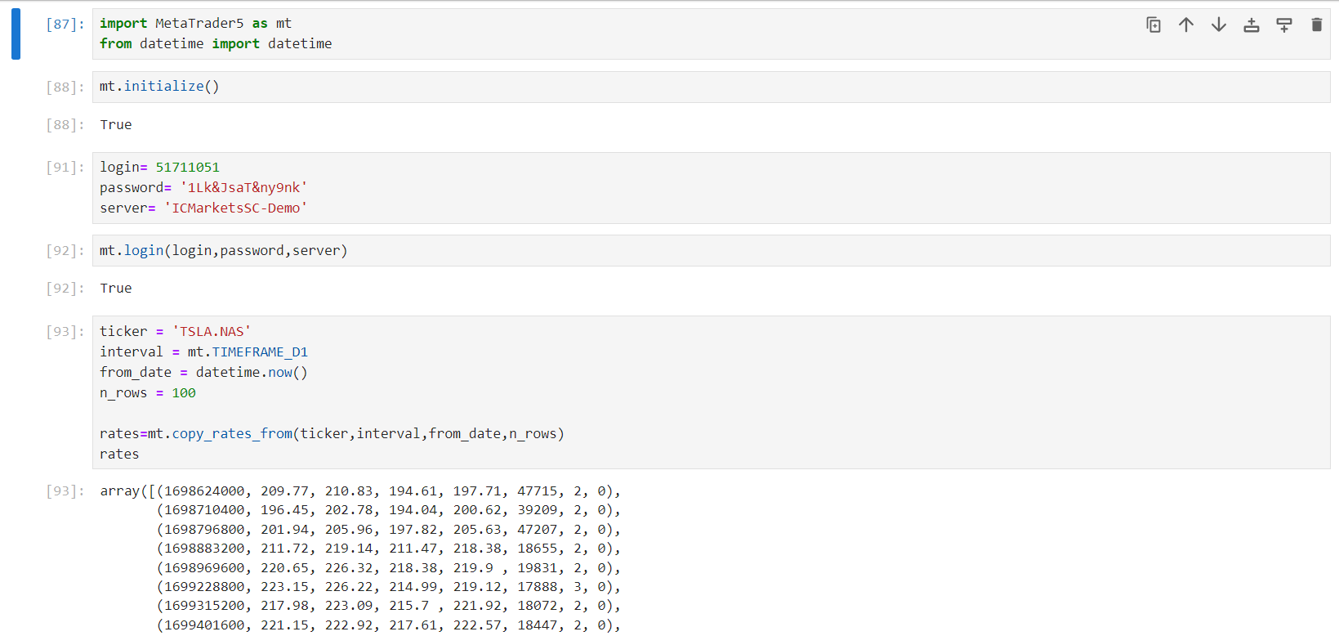
AMC ENGINEERING COLLEGE Department of Information Science and Engineering
IMPLEMENTATION

Slide 20
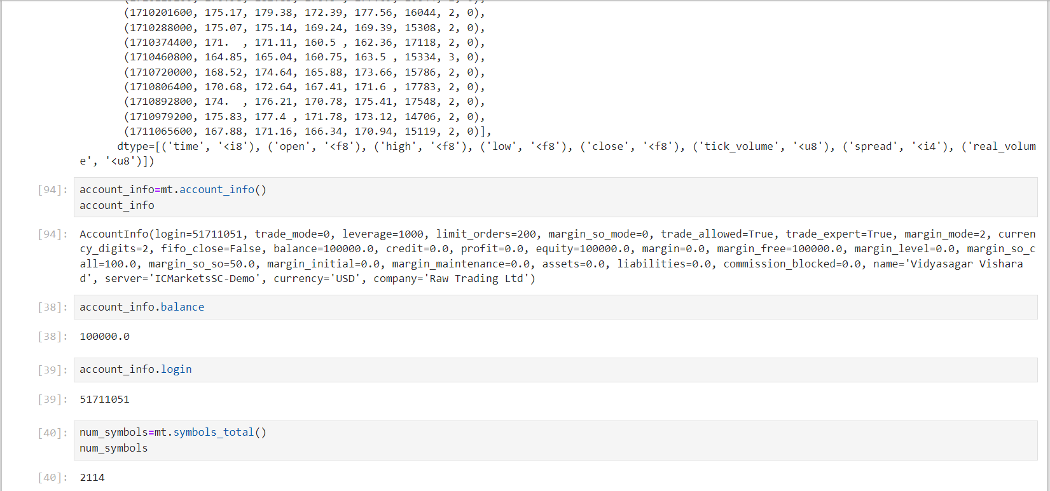
AMC ENGINEERING COLLEGE Department of Information Science and Engineering
IMPLEMENTATION

Slide 21
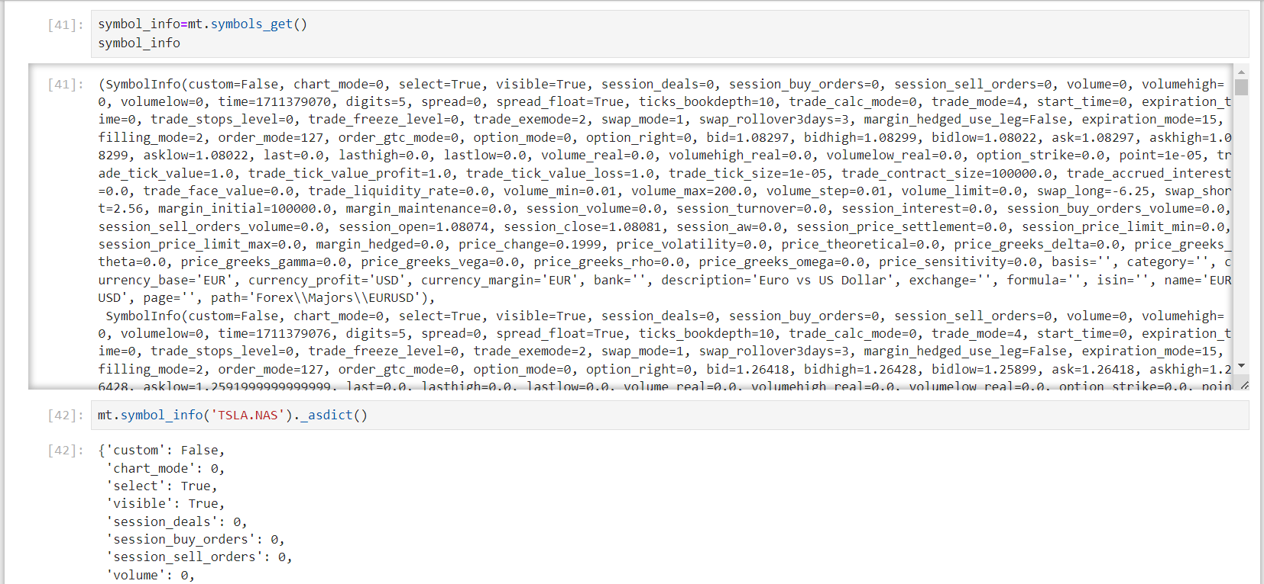
AMC ENGINEERING COLLEGE Department of Information Science and Engineering
IMPLEMENTATION

Slide 22
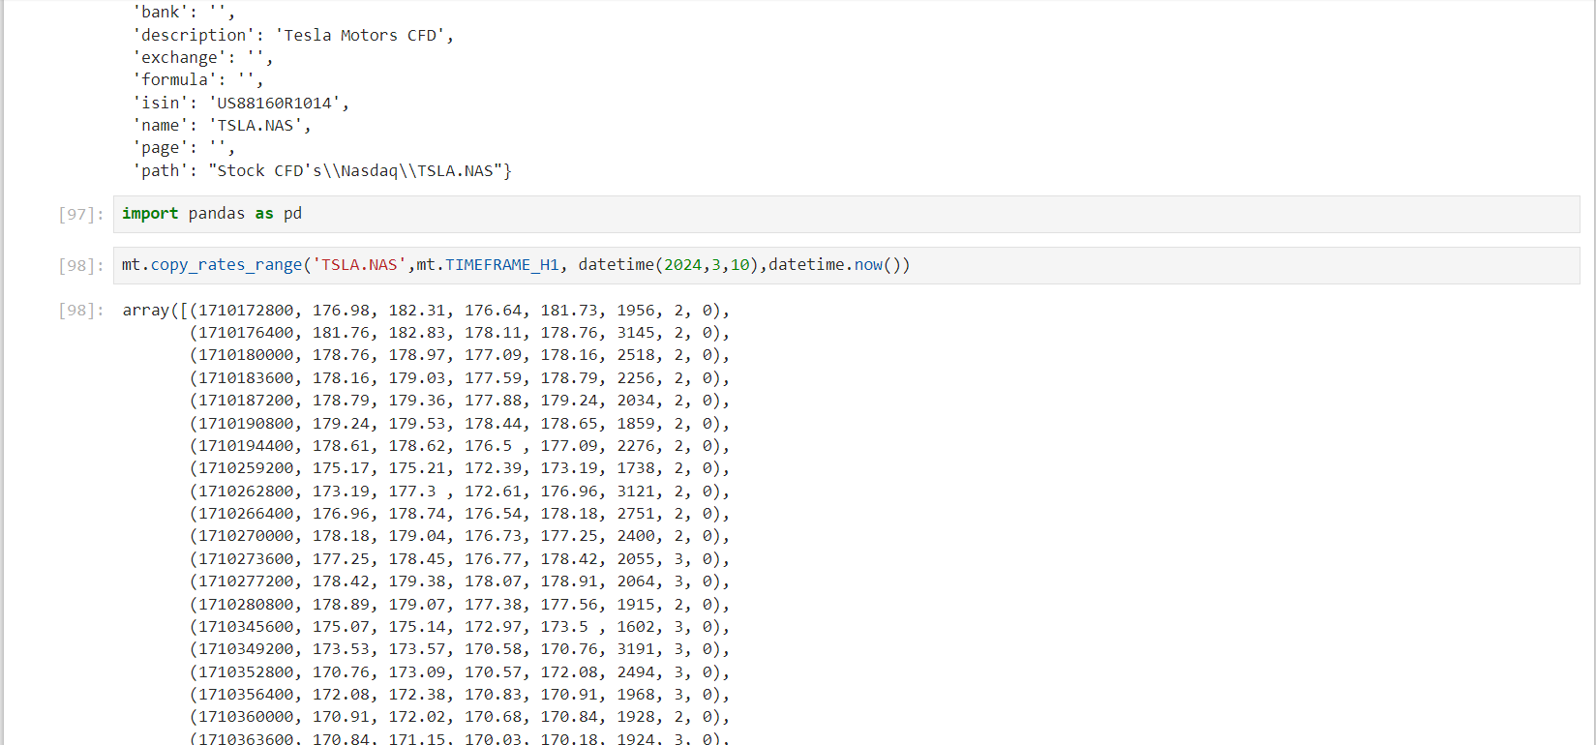
AMC ENGINEERING COLLEGE Department of Information Science and Engineering
IMPLEMENTATION

Slide 23
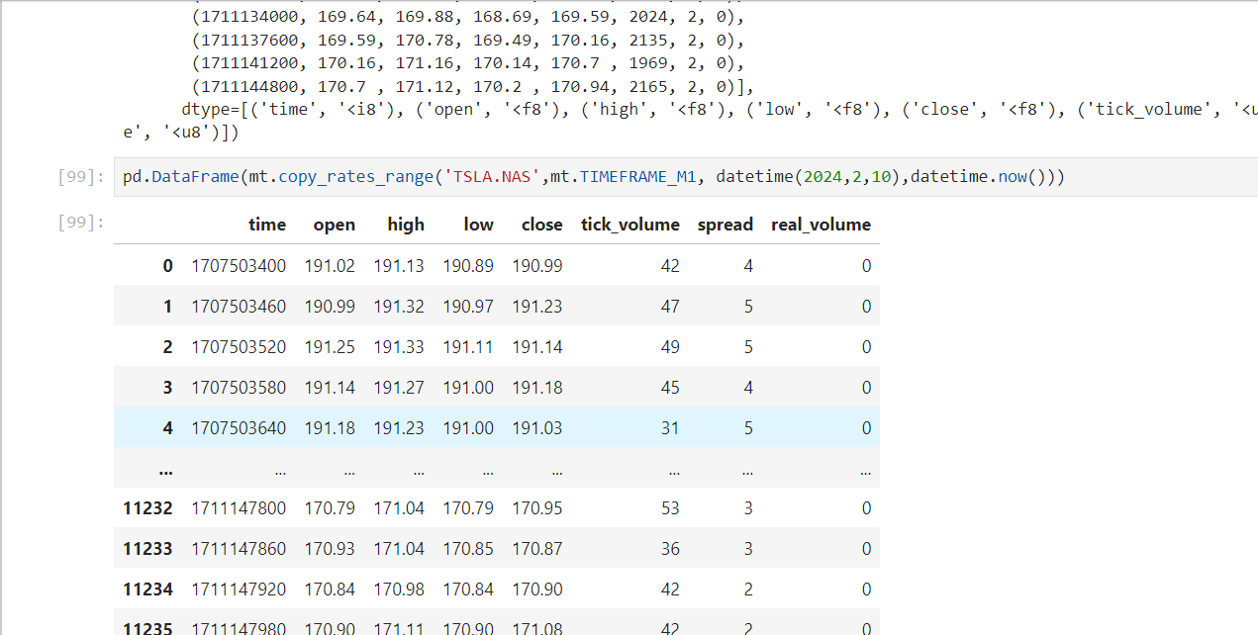
AMC ENGINEERING COLLEGE Department of Information Science and Engineering
IMPLEMENTATION

Slide 24
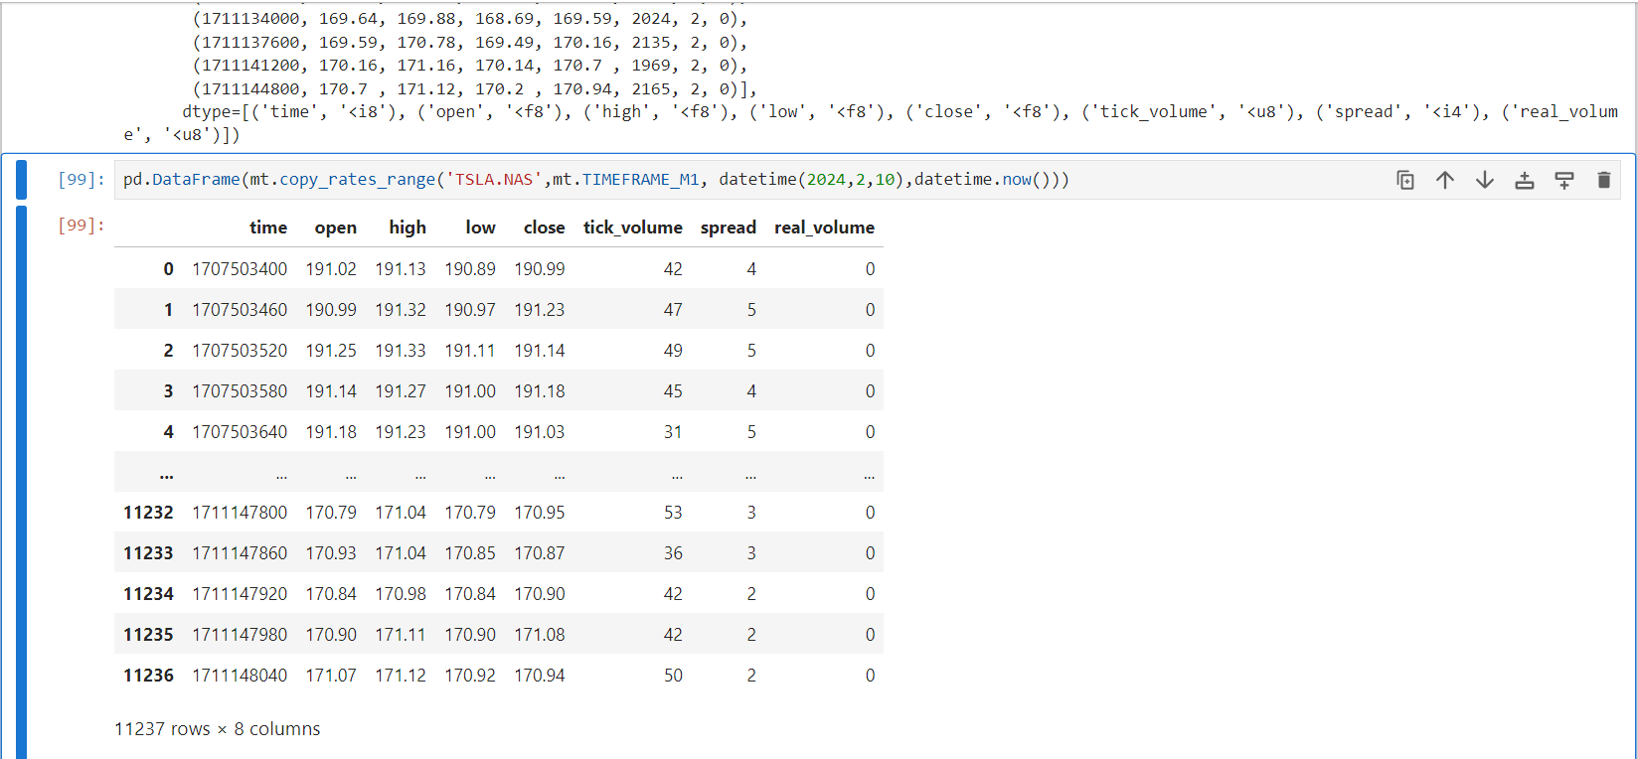
AMC ENGINEERING COLLEGE Department of Information Science and Engineering
IMPLEMENTATION

Slide 25
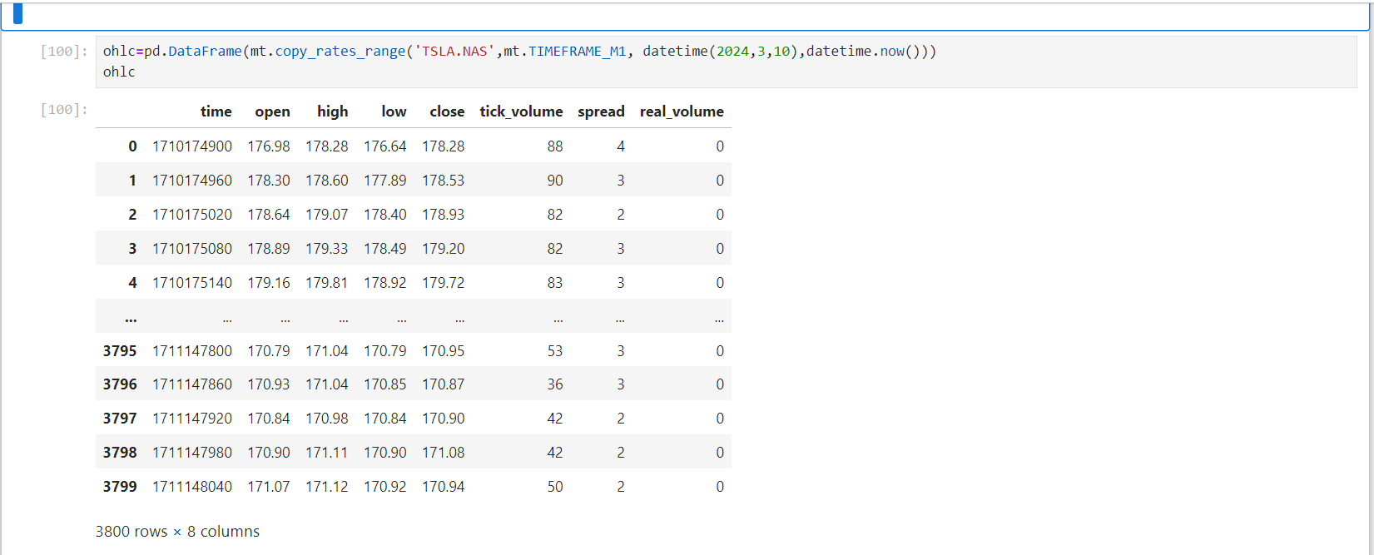
AMC ENGINEERING COLLEGE Department of Information Science and Engineering
IMPLEMENTATION

Slide 26
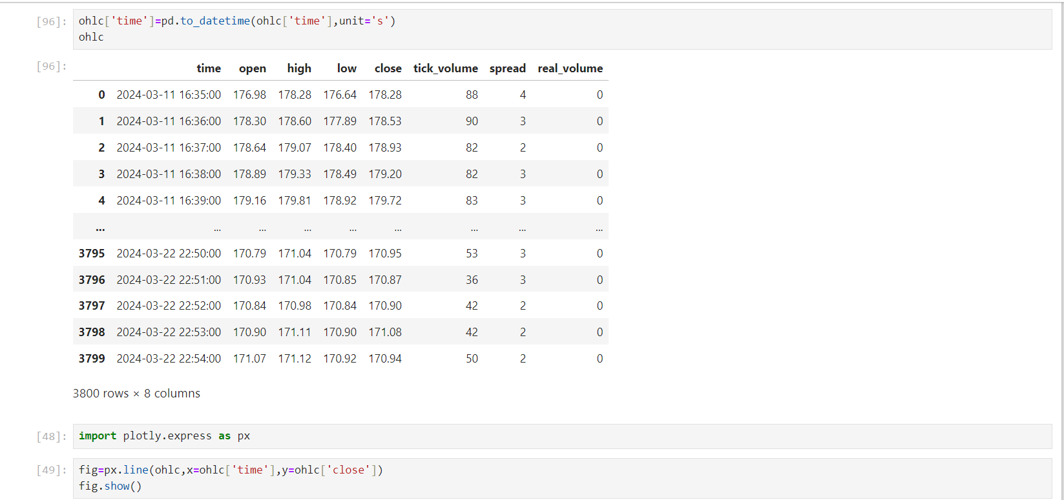
AMC ENGINEERING COLLEGE Department of Information Science and Engineering
IMPLEMENTATION

Slide 27
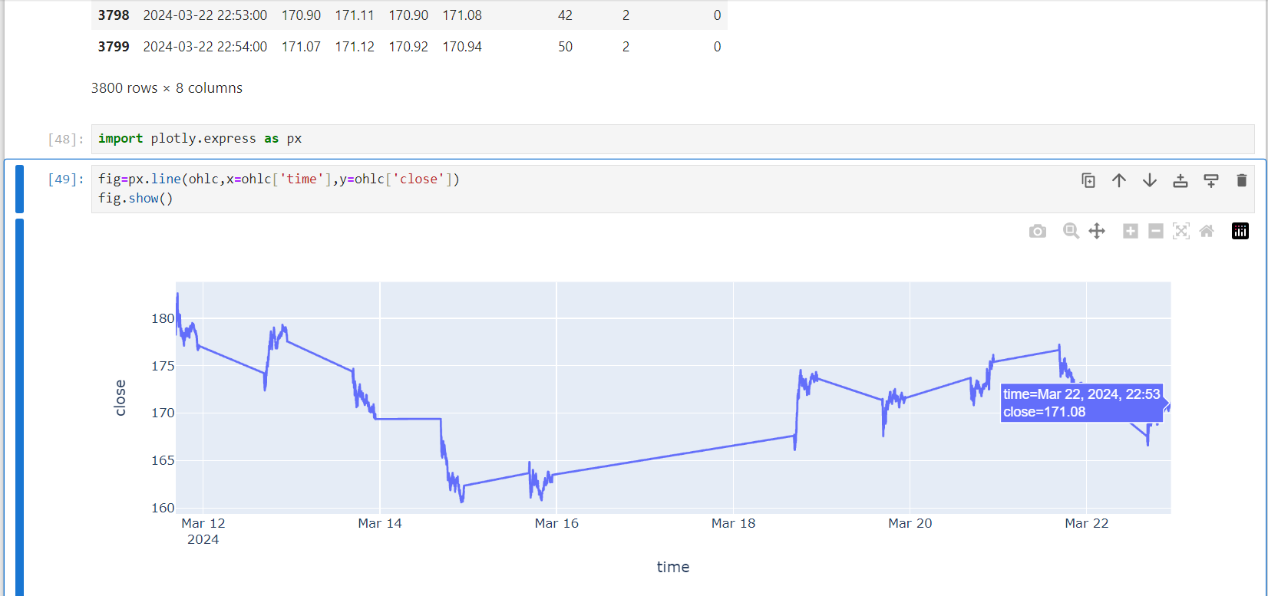
AMC ENGINEERING COLLEGE Department of Information Science and Engineering
IMPLEMENTATION

Slide 28
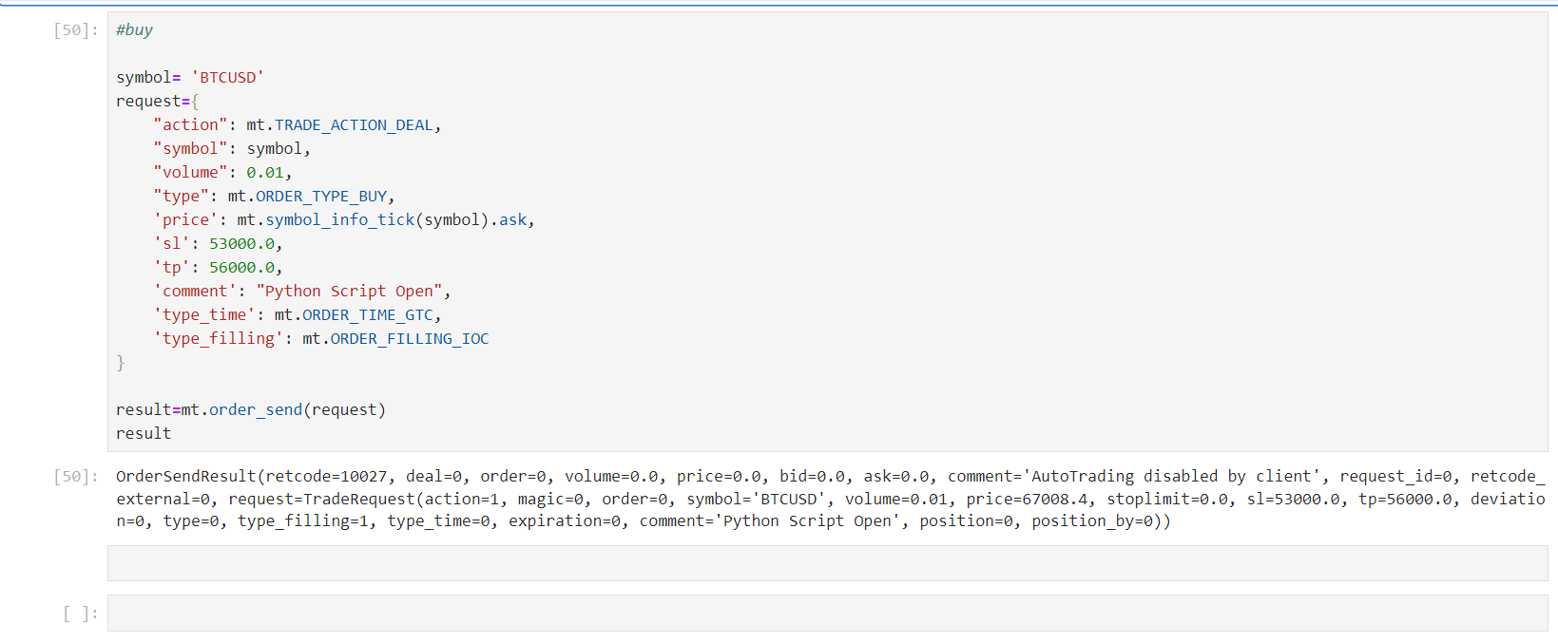
AMC ENGINEERING COLLEGE Department of Information Science and Engineering
IMPLEMENTATION

Slide 29
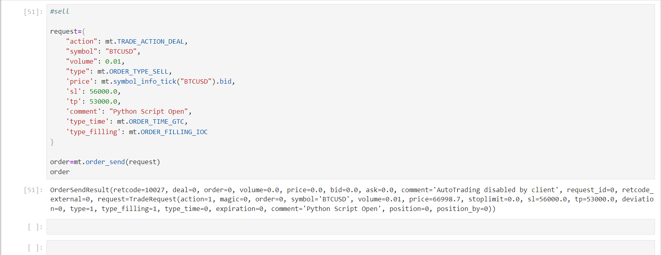
AMC ENGINEERING COLLEGE Department of Information Science and Engineering
IMPLEMENTATION

Slide 30
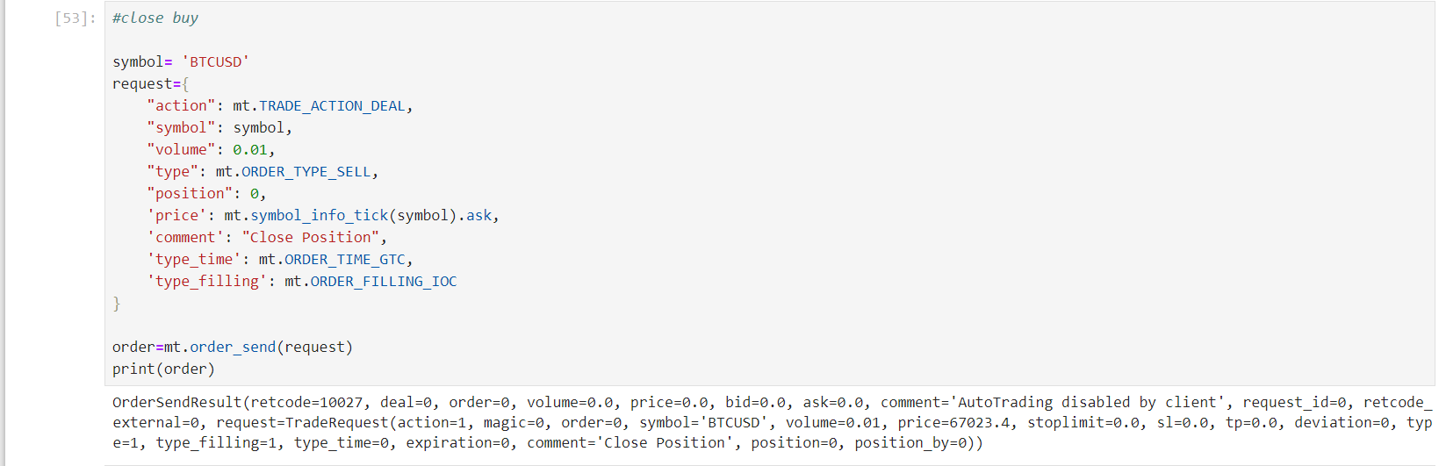
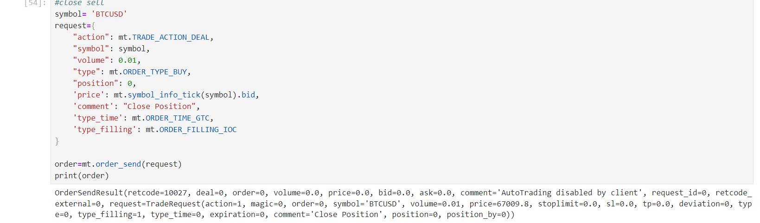
AMC ENGINEERING COLLEGE Department of Information Science and Engineering
IMPLEMENTATION

Slide 31
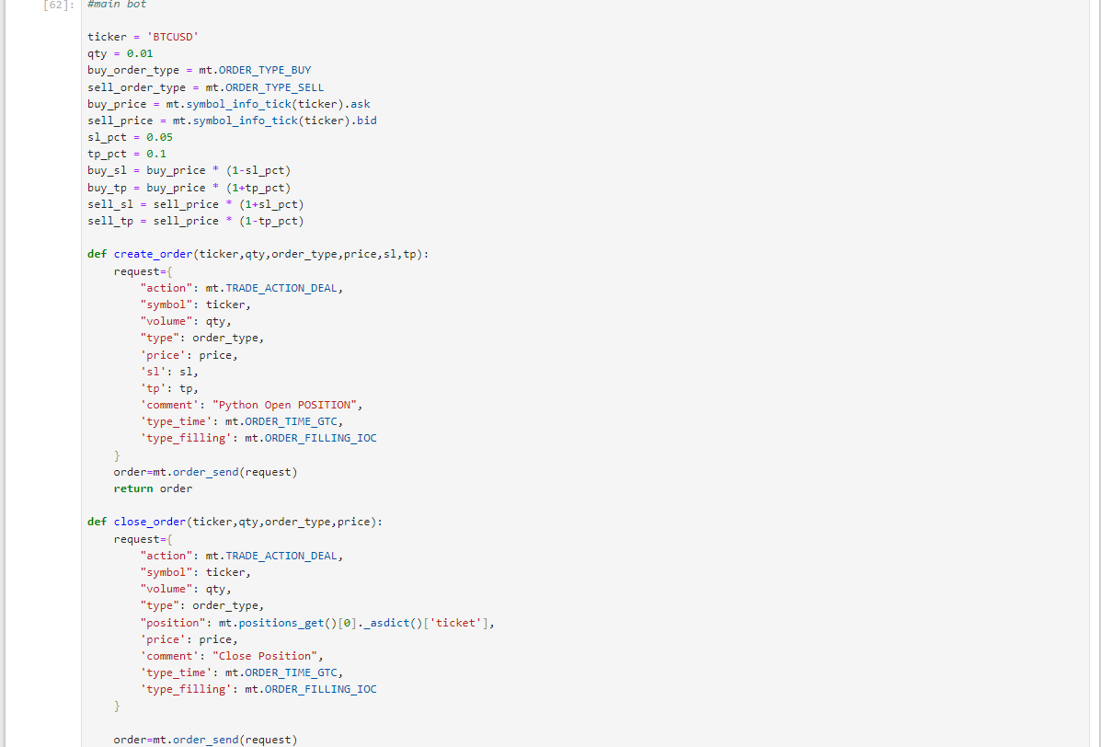
AMC ENGINEERING COLLEGE Department of Information Science and Engineering
IMPLEMENTATION

Slide 32
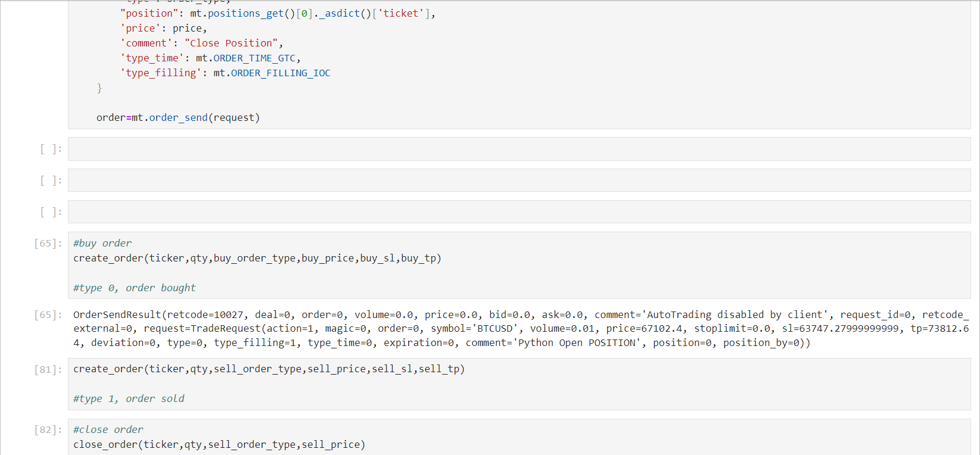
AMC ENGINEERING COLLEGE Department of Information Science and Engineering
IMPLEMENTATION

Slide 33
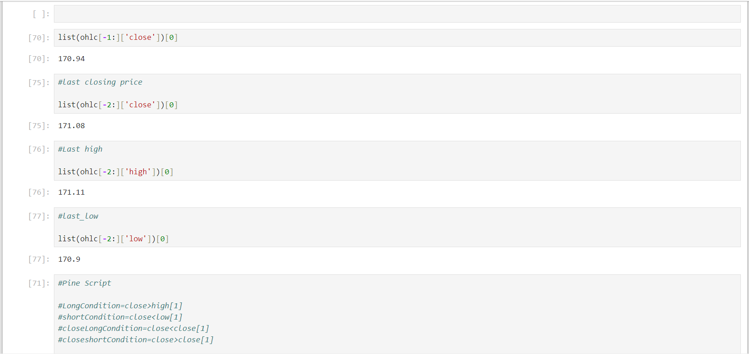
AMC ENGINEERING COLLEGE Department of Information Science and Engineering
IMPLEMENTATION

Slide 34
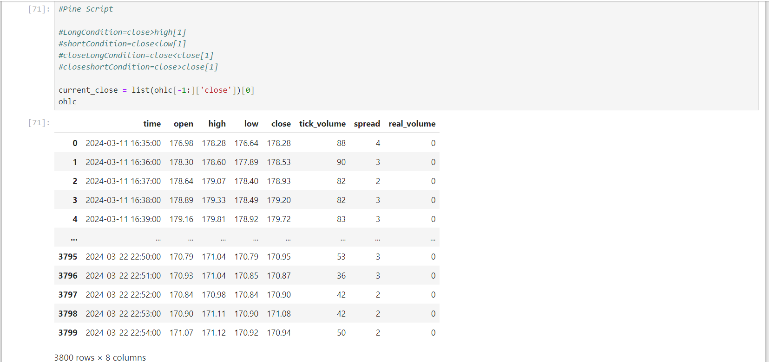
AMC ENGINEERING COLLEGE Department of Information Science and Engineering
IMPLEMENTATION

Slide 35
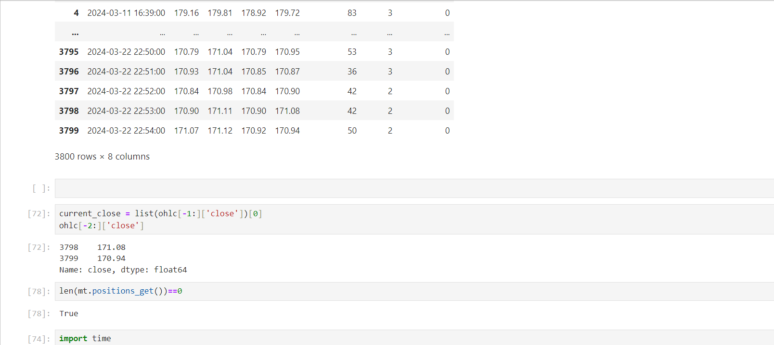
AMC ENGINEERING COLLEGE Department of Information Science and Engineering
IMPLEMENTATION

Slide 36
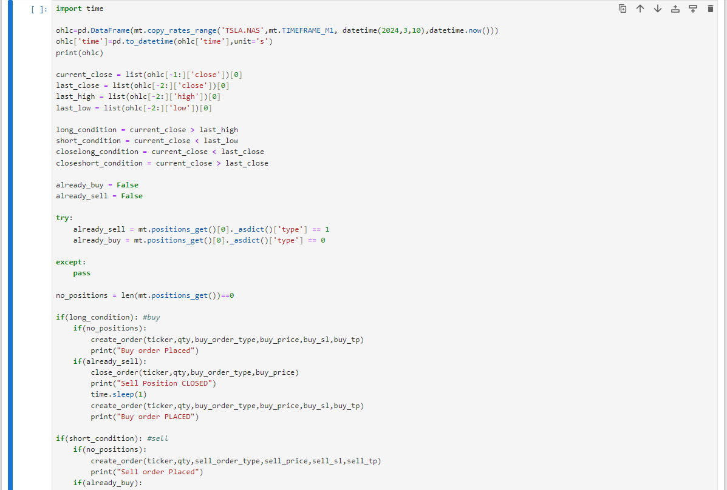
AMC ENGINEERING COLLEGE Department of Information Science and Engineering
IMPLEMENTATION

Slide 37
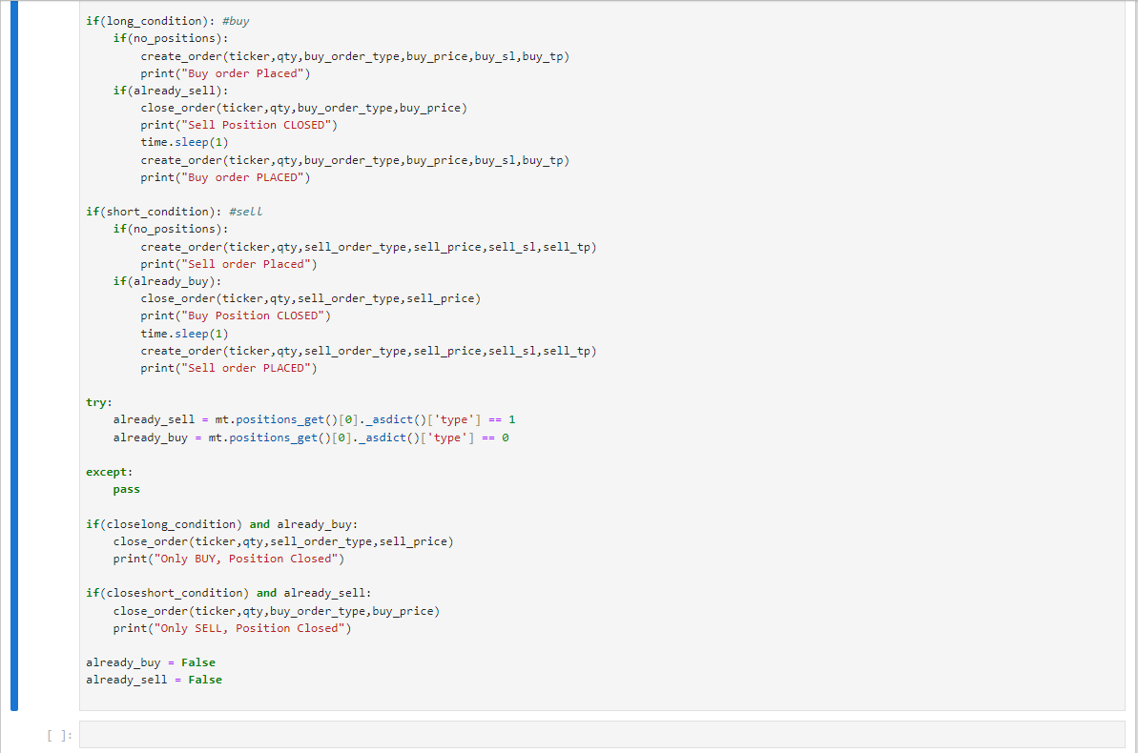
AMC ENGINEERING COLLEGE Department of Information Science and Engineering
IMPLEMENTATION

Slide 38
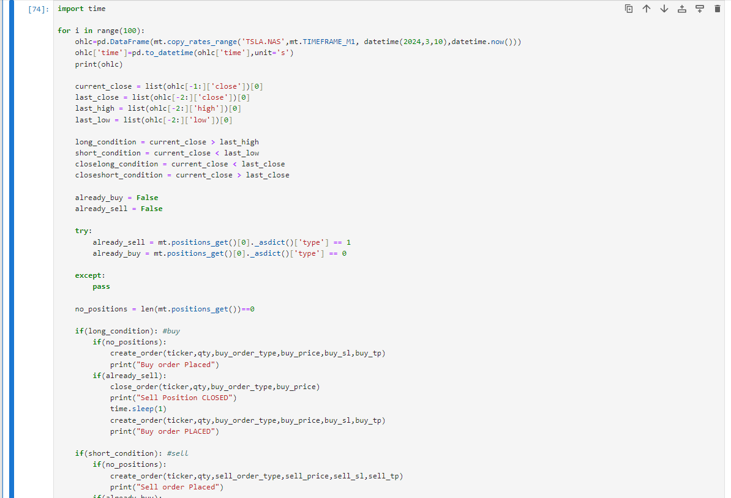
AMC ENGINEERING COLLEGE Department of Information Science and Engineering
IMPLEMENTATION

Slide 39
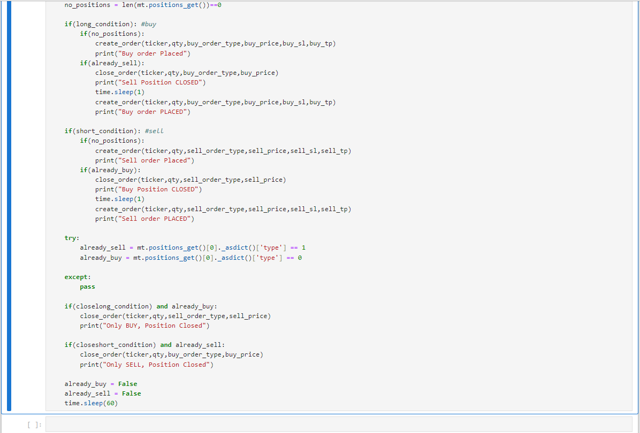
AMC ENGINEERING COLLEGE Department of Information Science and Engineering
IMPLEMENTATION

Slide 40
AMC ENGINEERING COLLEGE Department of Information Science and Engineering
RESULTS
The Bot successfully demonstrated the potential of artificial intelligence and automation in financial trading. By combining Long Short-Term Memory (LSTM) networks for predictive analytics with technical analysis tools like Golden Cross and Death Cross, the bot was able to generate effective trading signals and execute trades in an automated manner. The integration with MetaTrader5 (MT5) allowed for seamless trade execution and real-time market data collection. The Bot can deliver the following outcomes:
• The bot showed promising results in terms of profitability, with a consistent win rate and a favorable risk-adjusted return. The use of LSTM and traditional technical analysis provided a balanced approach to trading.
• Increased efficiency and accuracy in trading activities, potentially leading to higher returns on investment and reduced human error.
• Improved risk management through the implementation of predefined risk parameters and automated stop-loss mechanisms.

Slide 41
AMC ENGINEERING COLLEGE Department of Information Science and Engineering
REFERENCES
Reference to a Conference publication:
Zhang et. al., [1] “A Deep Reinforcement Learning Approach for Stock Trading (2018)”.
Jiang et. al., [2] “An Ensemble Learning Framework for Algorithmic Trading(2019)”.
Salah Bouktif et. al., [3] “Augmented Textual Features-Based Stock Market Prediction”
Arya Yudhi Wijaya et. al., [4] “Stock Price Prediction with Golden Cross and Death Cross on Technical Analysis Indicators Using Long Short-Term Memory (2022)”, in Dec. 2022
Gourav Bathla et. al., [5] “Stock Price prediction using LSTM and SVR”, at Waknaghat, India in Nov.2020
Xiaojian Weng et. al.,[6] “Stock Price Prediction Based on LSTM And Bert”, at Japan in Sep.2022
Sparsh Vohara et. al., [7] "Stock Price Trend Analysis and Prediction of Closing Price Using LSTM (2023)“, at Coimbatore India in Jan. 2023
Reference to Web Resources:
GeeksforGeeks: They have a detailed project idea on an Algorithmic Trading Bot.
GitHub: There are numerous repositories related to trading bots on GitHub.

Slide 42
AMC ENGINEERING COLLEGE Department of Information Science and Engineering
Thank You

